Slide 1
Algorithm Analysis- Asymptotic Analysis
Tanjina Helaly
Algorithms

Slide 2
Measure Time to run an algorithm
One naïve way is to implement the algorithm and run it in a machine.
This time depends on
the speed of the computer,
the programming language,
the compiler that translates the program to machine code.
the program itself.
And many other factors
So, you may get different time for the same algorithm.
Hence, not a good tool to compare different algorithm.
To overcome these issues, need to model Time complexity.

Slide 3
Time Complexity
Developing a formula for predicting how fast an algorithm is, based on the size of the input
To compare algorithms
Measure of efficiency/goodness of algorithm
3 types of complexity
Best case
Lower bound.
Minimum number of steps/operations to execute an algorithm.
Measure the minimum time required to run an algorithm.
Not a good measure of Algorithm’s performance.

Slide 4
Time Complexity
Worst case
Upper Bound
Maximum # of operations/time required to execute
Main focus
Reduce risks as it gives the highest time of algorithm execution
Average case
the amount of some computational resource (typically time) used by the algorithm, averaged over all possible inputs.
Difficult to determine
Typically follow the same curve as worst

Slide 5
Time Complexity
The best, worst, and average case time complexities for any given algorithm are numerical functions over the size of possible problem instances.
However, it is very difficult to work precisely with these functions,
Depends on specific input size.
Not a smooth curve
Require too much detail
So, need more simplification or abstraction.

Slide 6
Asymptotic analysis
We ignore too much details steps such as
Initialization cost
Implementation of specific operation.
Rather we focus on
how the time change if input doubles/triples
Or how many more operations do we need for that change.

Slide 7
A sample complexity equation
f(n) = 2n² + 10n + 3
How does each term effected by change of n?
For n=1000
2n²=2000000
10n = 10000
Ratio: 2n²/10n = 200 -> 0.5% of 2n²
For n = 1000000
2n² = 2000000000000
10 n = 10000000
Ratio: 2n²/10n = 200000 -> 0.0005% of 2n²
So, as n grows the lower order term become insignificant.

Slide 8
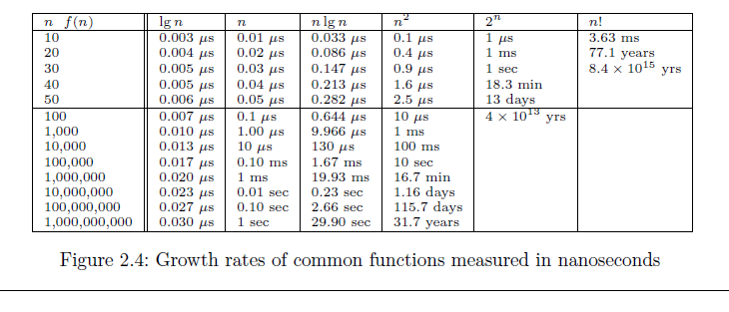
Comparison of Growth rate

Slide 9
A sample complexity equation
Do similar analysis for the equations below.
f(n) = 2n² + 10n + 3
f(n) = 5n² + 6n + 35
Will you get different result?
No,
As n->∞, all lower order terms become so insignificant that we can just ignore them.
Order of growth:
How the time grow with input size
Leading term/Highest order term in the equation

Slide 10
More to think
Tell me what types of equation are the following 2?
f(n) = 2n²
f(n) = 5n²
Does the coefficient impact the characteristics of the curve?
Can we ignore the coefficient?
YES,
Why:
constant factors are less significant than the rate of growth in determining computational efficiency for large inputs.

Slide 11
More to think
So, in terms of algorithm analysis, we can think
f(n) = 2n² + 10n + 3 ~ n² or (n²)
f(n) = 5n² + 6n + 35 ~ n² or (n²)

Slide 12
Asymptotic Analysis
Classifying functions into different category.
Formally, given functions f and g of a variable n, we define a binary relation
f ∼ g ( as n → ∞ )
f and g grows the same way as their input grows.
In Asymptotic Analysis,
we evaluate the performance of an algorithm in terms of input size
Do not measure the actual running time
We calculate, how does the time (or space) taken by an algorithm increases with the input size.

Slide 13
Asymptotic Notation
There are 3 Asymptotic notations as follows:
Big Theta
f(n) = Θ(g(n)) means c1· g(n) is an upper bound on f(n) and c2· g(n) is a lower bound on f(n), for all n ≥ n₀. Thus there exist constants c1 and c2 such that f(n) ≤ c1·g(n) and f(n) ≥ c2·g(n). This means that g(n) provides a nice, tight bound on f(n).
Big Oh
f(n) = O(g(n)) means c· g(n) is an upper bound on f(n). Thus there exists some constant c such that f(n) is always ≤ c · g(n), for large enough n (i.e. ,n ≥ n₀ for some constant n₀).
Big Omega
f(n) = Ω(g(n)) means c· g(n) is a lower bound on f(n). Thus there exists some constant c such that f(n) is always ≥ c· g(n), for all n ≥ n₀.

Slide 14
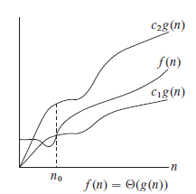
Big Theta-  notation
Θ(g(n)) = {f(n): there exist positive constants c₁, c₂ and n₀ such that 0 ≤ c₁g(n) ≤ f(n) ≤ c₂g(n) for all n >= n₀}
The theta notation bounds a functions from above and below, so it defines exact asymptotic behavior.
Thus g(n) provides a nice, tight bound on f(n).
Note:
The definition of asymptotic is a line that approaches a curve but never touches.

Slide 15
Big Theta-  notation
Easy way to get Theta notation is to
Drop lower-order terms
Ignore leading constant.
So, an³+bn+c = = Θ(n³)

Slide 16
How do we show that?
f(n) = 2n² + 10n + 3 = (n² )
To prove that we need to find a c₁, c₂ and n₀ so that
c₁n²<= 2n² + 10n + 3 <= c₂n² for n>=n₀
Obviously
2n² <= 2n² + 10n + 3 for any n
c₁ = 2
To calculate c₂ lets increase the power of each term to the highest power
2n² + 10n + 3 <= 2n² + 10n² + 3n² = 15n²
c₂ = 15

Slide 17
Another example
f(n) = 5n² + 6n + 35 = (n² )
To prove that we need to find a c₁, c₂ and n₀ so that
c₁n²<= 5n² + 6n + 35 <= c₂n² for n>=n₀
Obviously
5n² <= 5n² + 6n + 35 for any n>0
c₁ = 5
To calculate c₂ lets increase the power of each term to the highest power
5n² + 6n + 35 <= 5n² + 6n² + 35n² = 46n²
c₂ = 46 for n>0

Slide 18
More Examples
f(n) = 3n³ + 5n + 6 = (n³)
f(n) = n log n + 10n = (n log n)
f(n) = 2 + 1/n = (1)

Slide 19
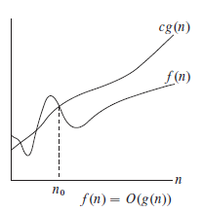
Big O notation
The Big O notation defines an upper bound of an algorithm, it bounds a function only from above.
O(g(n)) = { f(n): there exist positive constants c and n₀ such that 0 <= f(n) <= cg(n) for all n >= n₀}

Slide 20
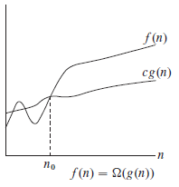
Big Omega - Ω Notation
Just as Big O notation provides an asymptotic upper bound on a function, Ω notation provides an asymptotic lower bound.
Ω (g(n)) = {f(n): there exist positive constants c and n₀ such that 0 <= cg(n) <= f(n) for all n >= n₀}.
Similar to the best case, the Omega notation is the least used notation among all three.

Slide 21
Relationship among those notation
For any two functions f(n) and g(n),
we have f(n) = Θ(g(n)) if and only if f(n) = O(g(n)) and f(n) = Ω(g(n)).
Θ(g(n)) = O(g(n)) ∩ Ω(g(n)).

Slide 22
Different functions
Constant functions, f(n) = c
Logarithmic functions, f(n) = log n
Linear functions, f(n) = n
Superlinear functions, f(n) = n lg n
Quadratic functions, f(n) = n²
Cubic functions, f(n) = n³
Exponential functions, f(n) = c^{n}
Factorial functions, f(n) = n!
n! ≥ 2^{n} ≥ n³ ≥ n² ≥ n log n ≥ n ≥ log n ≥ c

Slide 23
Try these
Is 2^{n+1} = O(2^{n})?
Is 2^{2n} = O(2^{n})?
For each of the following pairs of functions, either f(n) is in O(g(n)), f(n) is in Ω(g(n)), or f(n) = Θ(g(n)). Determine which relationship is correct and briefly explain why.
f(n) = logn²; g(n) = logn + 5
f(n) =√n; g(n) = logn²
f(n) = log² n; g(n) = logn
f(n) = n; g(n) = log² n
f(n) = n log n + n; g(n) = logn
f(n) = 10; g(n) = log10
f(n) = 2^{n}; g(n) = 10n²
f(n) = 2^{n}; g(n) = 3^{n}

Slide 24
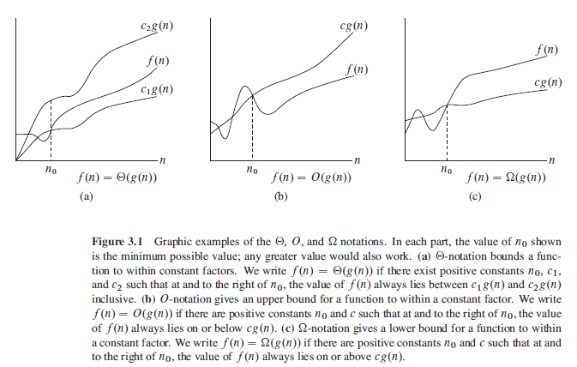
The Big Oh Notations

Slide 25
The Big Oh Notation
Because for c = 3, 3n² > 3n² − 100n + 6;
3n² − 100n + 6 = O(n²),
3n² − 100n + 6 = O(n³),
3n² − 100n + 6 ≠ O(n),
3n² − 100n + 6 = Ω(n²),
3n² − 100n + 6 ≠ Ω(n³),
3n² − 100n + 6 = Ω(n),
3n² − 100n + 6 = Θ(n²),
3n² − 100n + 6 ≠ Θ(n³),
3n² − 100n + 6 ≠ Θ(n),
Because for c = 1, n³ > 3n² − 100n + 6 when n > 3;
Because for any c, c ×n < 3n2 when n > c;
Because for c = 2, 2n² < 3n² − 100n + 6 when n > 100;
Because for c = 3, 3n² − 100n + 6 < n³ when n > 3;
Because for any c, cn < 3n² − 100n + 6 when n > 100c;
Because both O and Ω apply;
Because only O applies;
Because only Ω applies.

Slide 26
Reference
Chapter 2 + 3 (Cormen)

